Slide 1
Just for you not for the students
Dear colleagues,
I would like to request you to emphasis the proper sound, stress and intonation while presenting the content as it is a drama series. Please read the notes in normal mood carefully below the ‘Click to add notes’ option to conduct the class spontaneously. If you think any change to take the class more effectively, you can do that. In case of any inquiry please call 01556652300.
Your near and dear
Md. Hasan Hafizur Rahman
Content developer (English)
Cambrian School & College
Dhaka.
Notes:
Teacher may read the instructions carefully before going to the class.

Slide 2
Welcome to the grand episode dear students.
Notes:
Welcome slide. Teacher may change it .

Slide 3
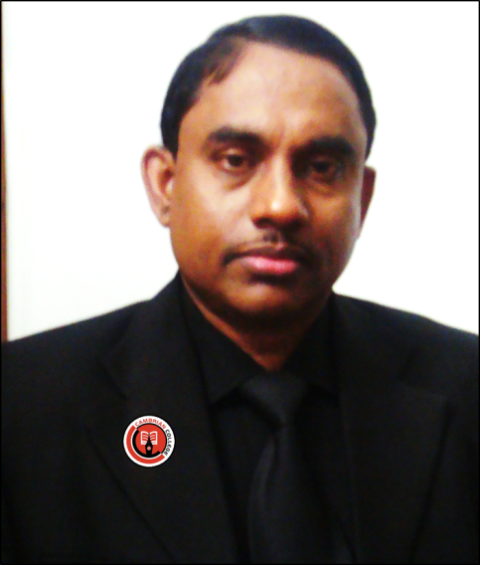
Introduction of the teacher & class
Md. Hasan Hafizur Rahman
Lecturer (English)
Cambrian School & College
Dhaka
English for Today
Class-IX-X
Notes:
Introduction of teacher & Class.

Slide 4
Learning outcomes
After studied this lesson, we will be able to –
ask and answer questions
listen information with proper sound, stress and intonation
describe and tell stories
Notes:
Speaking, listening and writing skills of English will be focused.

Slide 5
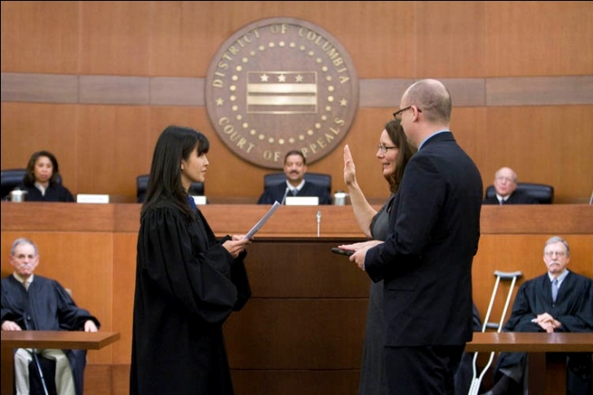
What do you mean by the picture?
Our today’s lesson is-
The Trial
Unit-14, Lesson-11
T
R
I
A
L

Slide 6
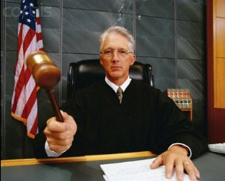
Let us know some new words to have clear idea about the story.
Duke
Chief justice,
Judge
The Duke came and entered into the court.
Notes:
If you want to show this option, just go according to the animation.

Slide 7
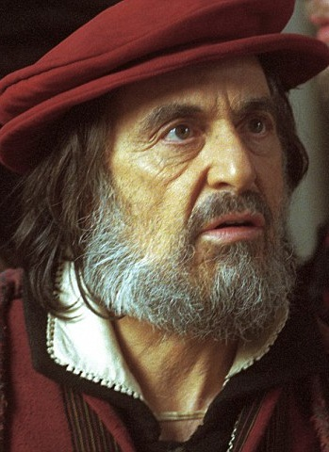
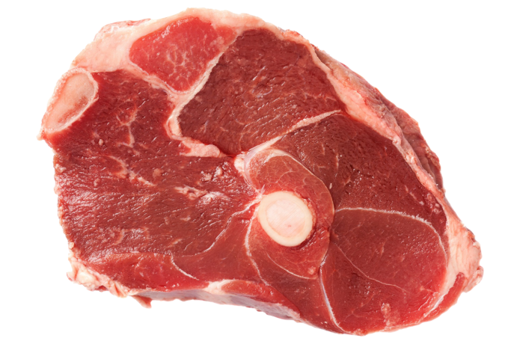
Claim
Due,
right
Shylock claimed a pound of flesh to Antonio.
Notes:
Showing the word teacher may ask the meaning to the students, then he may show the picture, then meaning and sentence at last.

Slide 8
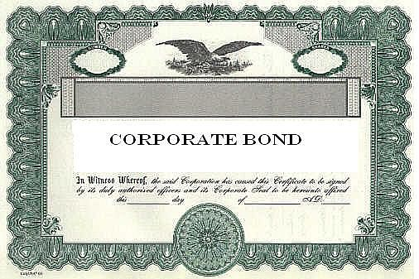
Bond
Promise,
pledge,
oath
Bond
Antonio signed in the bond to give Shylock a pound of flesh.
Notes:
Showing the word teacher may ask the meaning to the students, then he may show the picture, then meaning and sentence at last.

Slide 9
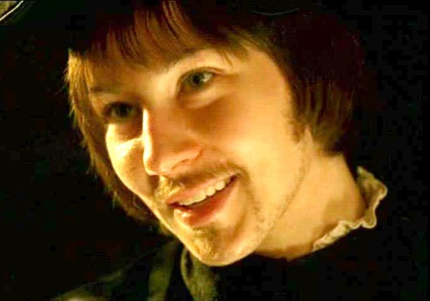
Disguise
Mask,
cover,
cloak
Portia came in disguise as a lawyer to defend Antonio.
Notes:
Showing the word teacher may ask the meaning to the students, then he may show the picture, then meaning and sentence at last.

Slide 10
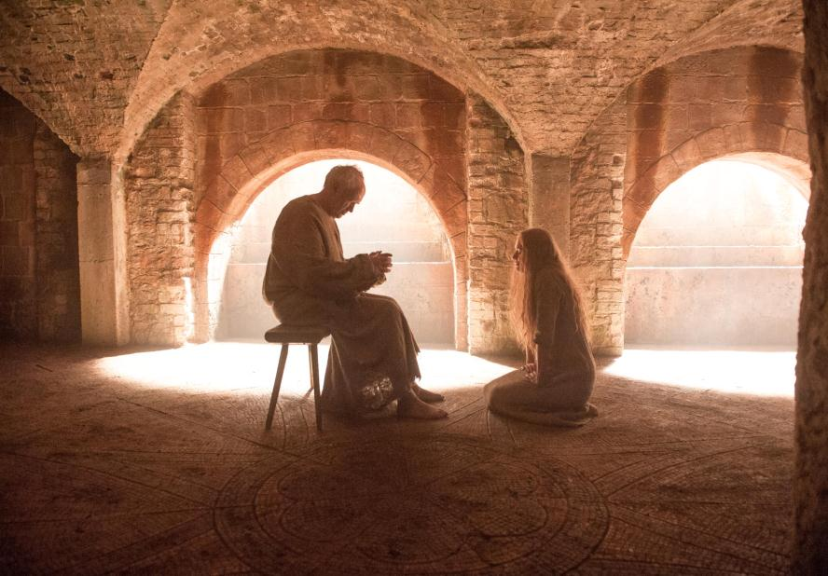
Bestows
Gives,
donates,
grants
God bestows mercy those who are merciful to others.
Notes:
Showing the word teacher may ask the meaning to the students, then he may show the picture, then meaning and sentence at last.

Slide 11
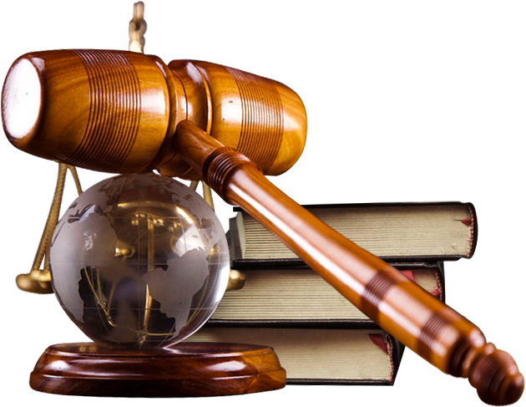
Righteousness
Virtue, morality,
justice
Shylock praised Portia for her wisdom and righteousness.
Notes:
Showing the word teacher may ask the meaning to the students, then he may show the picture, then meaning and sentence at last.

Slide 12
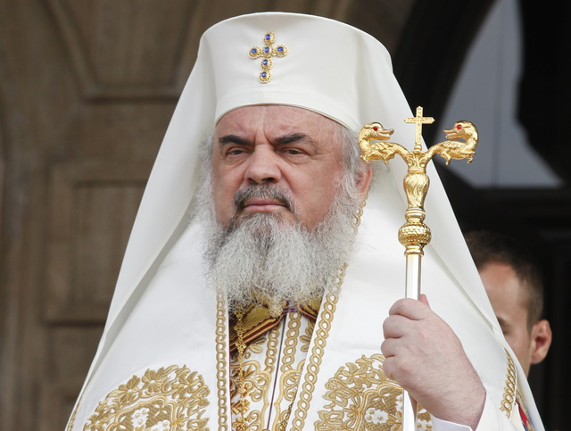
Daniel
Justice,
judge
Shylock told Portia the second Daniel.
Notes:
Showing the word teacher may ask the meaning to the students, then he may show the picture, then meaning and sentence at last.

Slide 13
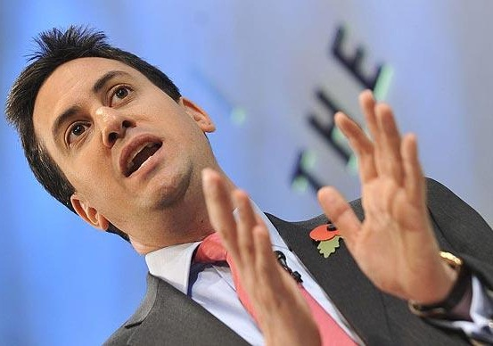
Urged
Requested,
advised
Portia urged Shylock to cut the pound of flesh.
Notes:
Showing the word teacher may ask the meaning to the students, then he may show the picture, then meaning and sentence at last.

Slide 14
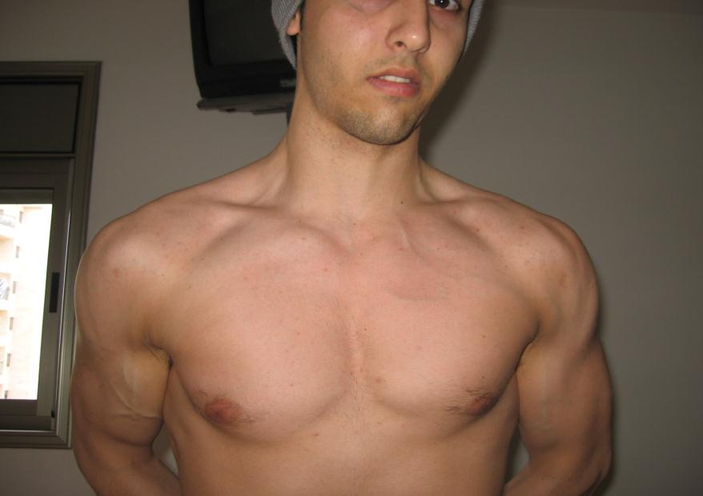
Chest
Upper body
ribcage,
ribs
Shylock told Antonio to uncover his chest.
Notes:
Showing the word teacher may ask the meaning to the students, then he may show the picture, then meaning and sentence at last.

Slide 15
Bassanio was passing his days with joy, cheer, and merriments in Belmont. But, by this time, three months were over. Antonio could not pay the three thousand ducats to Shylock as he lost all his ships in the sea.
Let’s have a look how Antonio was.
Notes:
Bad fate of Antonio

Slide 16
Antonio sent a messenger to Bassanio with a letter. The letter said, “ Dear friend Bassanio, all my ships have been lost at sea. I cannot pay the money I owe to Shylock. So I have to pay the penalty. Dear friend, come and see me if possible. I would like to see you once before I die.” Bassanio quickly left for Venice and…………………………………
Notes:
Disappointed Antonio

Slide 17
Soon a young clerk entered the courtroom with a letter from the wise lawyer of Venice. The lawyer was ill and would not be able to come to the court. He requested the Duke to let his young friend, Doctor Balthazar, defend Antonio. The Duke gave his permission, and Doctor Balthazar entered the courtroom.
Notes:
Drama began

Slide 18
Doctor Balthazar (Portia in disguise) wanted to see the bond. Shylock handed the bond to her. She read it with great attention and then said, “ You are right Shylock. The law is on your side. You can claim the flesh. But I would request you one more time to accept the sum Bassanio is offering you, and let me tear up the bond.” But Shylock would not give up his claim. Portia then turned towards Antonio and said, “ Get ready Antonio for Shylock to cut his pound of flesh. The law gives it to him.”
Shylock was filled with joy on hearing what Portia said. He began to praise Portia in disguise, for her wisdom and righteousness. He cried out, “Oh noble judge! Oh excellent young man, you are a second Daniel, who has come to this earth.”
Notes:
Drama of portia.

Slide 19
Portia urged Shylock to cut the pound of flesh he demanded. Delighted, Shylock walked towards Antonio with a knife in hand. He told Antonio to uncover his chest. Antonio uncovered his chest and …...
Notes:
Suspension of the story

Slide 20
As Shylock was about to cut Antonio’s flesh………
Notes:
Climax of the story.

Slide 21
Portia cried out, “ Stop, Wait Shylock! Never forget - there is no mention of blood in the bond. Therefore, you cannot shed a single drop of blood while you cut your pound of flesh; or else you pay the penalty. And the penalty is, the state will take your property from you. You lose everything that you have now, Shylock.” Shylock understood it was not possible for him to cut a pound of flesh without shedding blood. He was defeated by the wise lawyer. He hung his head and without another word left the courtroom. Thus Antonio’s life was saved.
Notes:
Last scene of the story

Slide 22
Answer the following questions
1. Describe the court scene.
2.Who was Portia? What do you know about her?
3. What did Portia say regarding mercy?
4. How did Portia save Antonio’s live?
5. Sketch the character of Antonio.
6. How do you evaluate the character of Shylock.
Notes:
Evaluation of the lesson

Slide 23
This is all of the drama series
“The Merchant of Venice”
by William Shakespeare
Allah Hafez
Notes:
Ending slide

